Slide 1
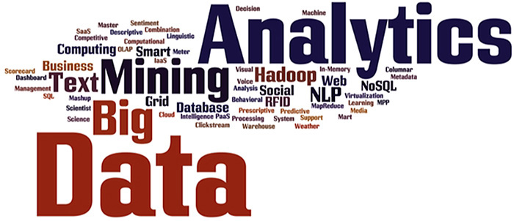
CMSC 462 – Introduction to Data Science
Abhijit Dutt

Slide 2




Abhijit Dutt Professor of the Practice, CSEE, ITE 311
Ph.D. (Major – Information Systems, Minor –Operations)
Lubar School of Business, University of Wisconsin-Milwaukee
M.S. (Computer Science)
Tandy School of Computer Science, University of Tulsa
M.Sc. (Physics), Calcutta University
B.Sc. (Major- Physics, Minor- Statistics), St. Xavier’s College

Slide 3
My Experience
Academic
Sixteen years’ of full time experience
Five years’ of adjunct teaching
Many different types of universities and colleges
Industry
More than ten years’ of fulltime experience
Networking and Financial industry
Part of two successful startups in the Boston area

Slide 4

The course
It is an introductory course, if you have taken an advanced course such as machine learning then you will not find this very useful
During the first half of course, we shall use R. So please download Rstudio and R https://rstudio.com/products/rstudio/download/
Later on we will probably use Python and maybe Scala

Slide 5
The Course (Cont)
Two tests & final
Many homework and Assignments
Needs to be done using R

Slide 6
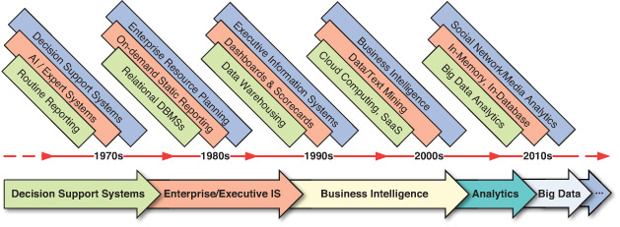

Slide 7
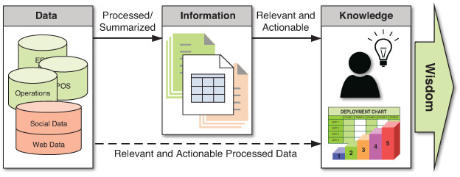

Slide 8
What is Data Science?
Data scientists, "The Sexiest Job of the 21st Century" (Davenport and Patil, Harvard Business Review, 2012)
Much of the data science explosion is coming from the tech-world
What does Data Science mean?
Is it the science of Big Data?
What is Big Data anyway?
Who does Data Science and where?
What existed before Data Science came along?
Is it simply a rebranding of statistics and machine learning?
“Anything that has to call itself a science isn’t.”
Hype increases noise-to-signal ratio in perceiving reality and makes it harder to focus on the gems
Why and how to hire a data scientist? http://goo.gl/F4K4hE

Slide 9
Why now?
Ever shrinking cost of storage (Lomet, 2018)
Cloud Computing, Smartphones, Sensor Networks
massive amounts of data about many aspects of our lives, both online and offline activities, real-time as well as past-time
Datafication=“taking all aspects of life and turning them into data”
“Once we datafy things, we can transform their purpose and turn the information into new forms of value.”
abundance of inexpensive computing power, communication capacity
proliferation of small footprint low-power sensors (IoT)
feedback loop between our behavior, environment, and data products

Slide 11
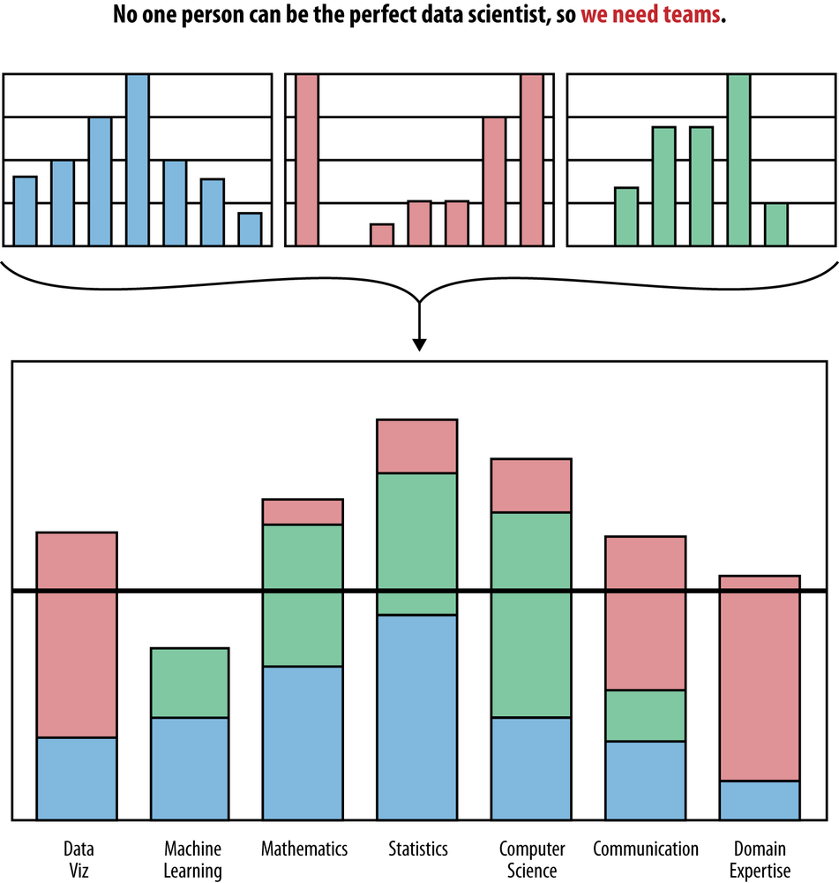
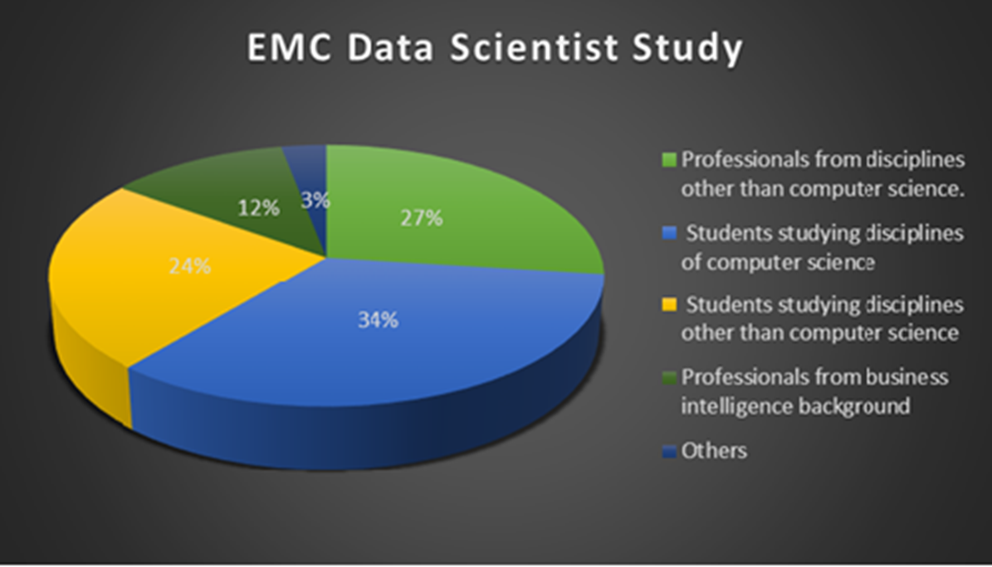
Data Science team
individual data scientist profiles are merged to make a Data science team
team profile should align with the profile of the data problems to tackle

Slide 12
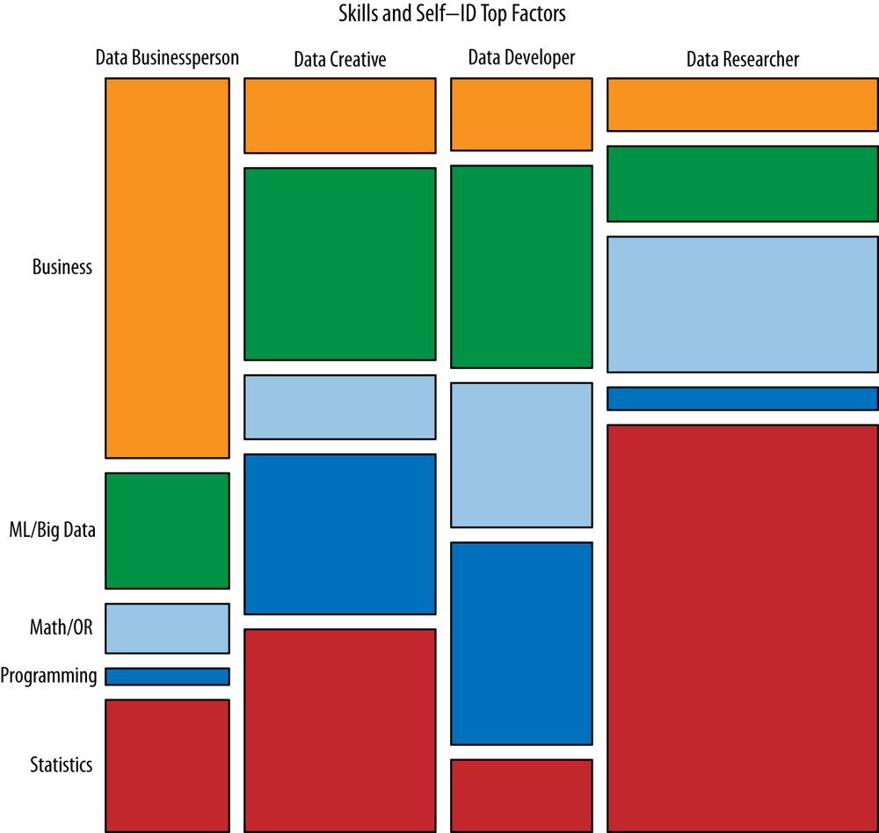
Data science: skills and actors
Clustering and visualization of data science subfields based on a survey of data science practitioners (Analyzing the Analyzers by Harlan Harris, Sean Murphy, and Marck Vaisman, 2012)
Data Businesspeople are the product and profit-focused data scientists. They’re leaders, managers, and entrepreneurs, but with a technical bent. A common educational path is an engineering degree paired with an MBA.
Data Creatives are eclectic jacks-of-all-trades, able to work with a broad range of data and tools. They may think of themselves as artists or hackers, and excel at visualization and open source technologies.
Data Developers are focused on writing software to do analytic, statistical, and machine learning tasks, often in production environments. They often have computer science degrees, and often work with so-called “big data”.
Data Researchers apply their scientific training, and the tools and techniques they learned in academia, to organizational data. They may have PhDs, and their creative applications of mathematical tools yields valuable insights and products.

Slide 13
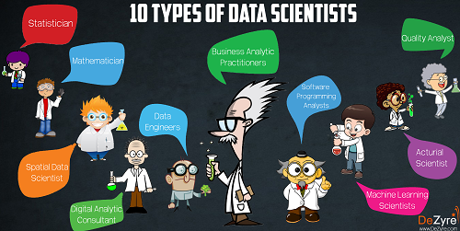
Types of Data Scientists
Machine Learning Scientist
Statistician
Software Programming Analyst
Data Engineer
Actuarial Scientist
Business Analytic Practitioner
Quality Analyst
Spatial Data Scientist
Mathematician
Digital Analytic Consultant

Slide 14
What do data scientists do?
“define what data science is by what data scientists get paid to do” (O’Neil and Schutt)
In academia, a data scientist is trained in some discipline, works with large amounts of data, grapples with computational problems posed by the structure, size, messiness, and the complexity and nature of the data, and solves real-world problems.
In industry, a data scientist
knows how to extract meaning from and interpret data, which requires both tools and methods from statistics and machine learning, as well as being human.
spends a lots of effort in collecting, cleaning, and munging data utilizing statistics and software engineering skills.
performs exploratory data analysis, finds patterns, builds models, and algorithms.
communicates the findings in clear language and with data visualizations so that even if her/his colleagues unfamiliar with the data can understand the implications

Slide 15
Data Science take II
“Data science, also known as data-driven science, is an interdisciplinary field about scientific methods, processes, and systems to extract knowledge or insights from data in various forms, either structured or unstructured, similar to data mining.” (Wikipedia)
The 4th paradigm of science (theoretical, empirical, computational, and data-driven) (Jim Gray)
https://www.kdnuggets.com/2017/09/data-science-imposter-syndrome.html
(Sometimes we feel whether we are imposters)

Slide 16
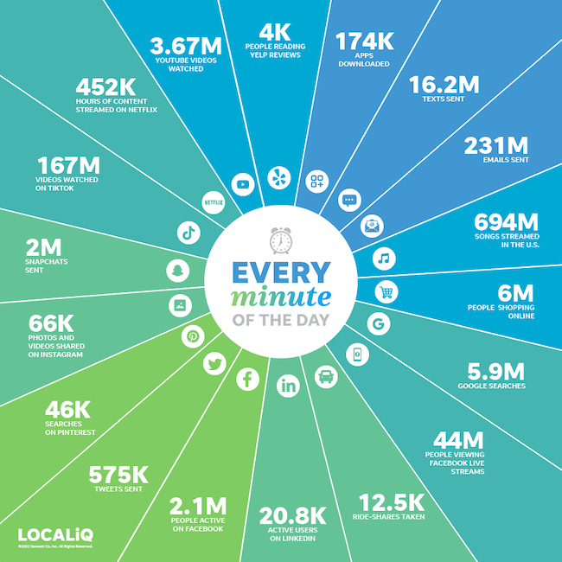
2023 – What happens in one minute

Slide 17
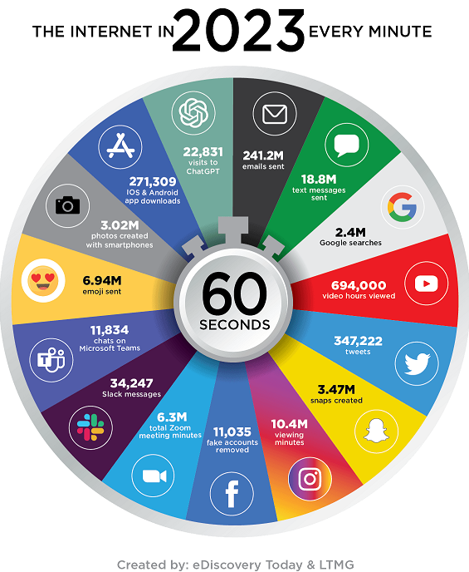

Slide 18
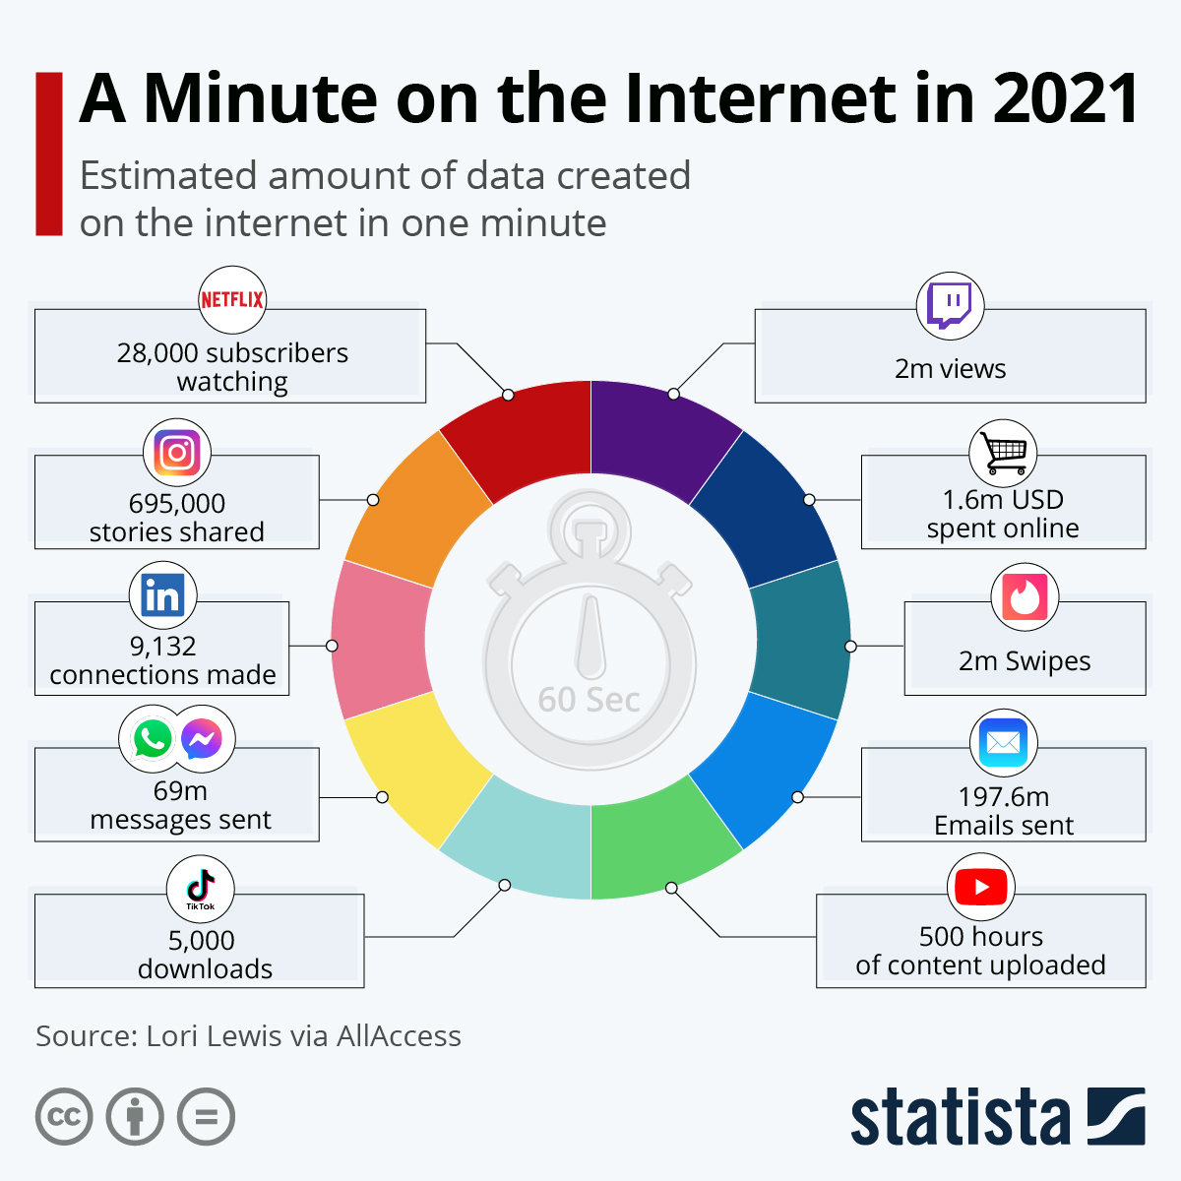

Slide 19
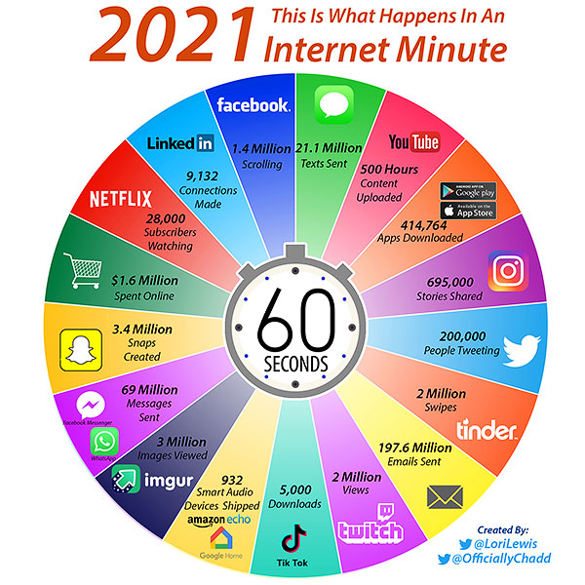

Slide 20
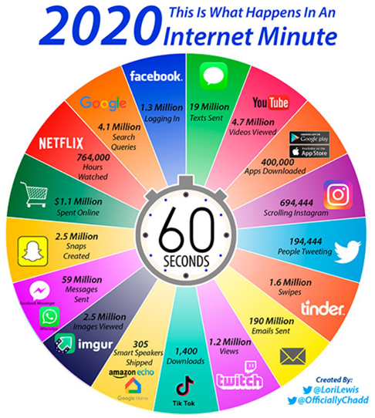

Slide 21
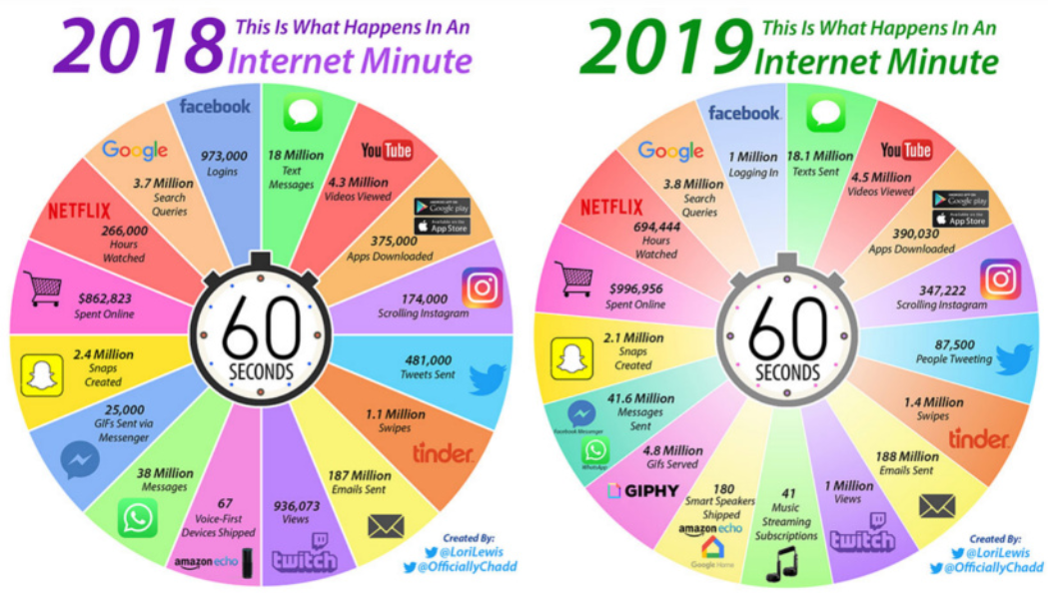

Slide 22
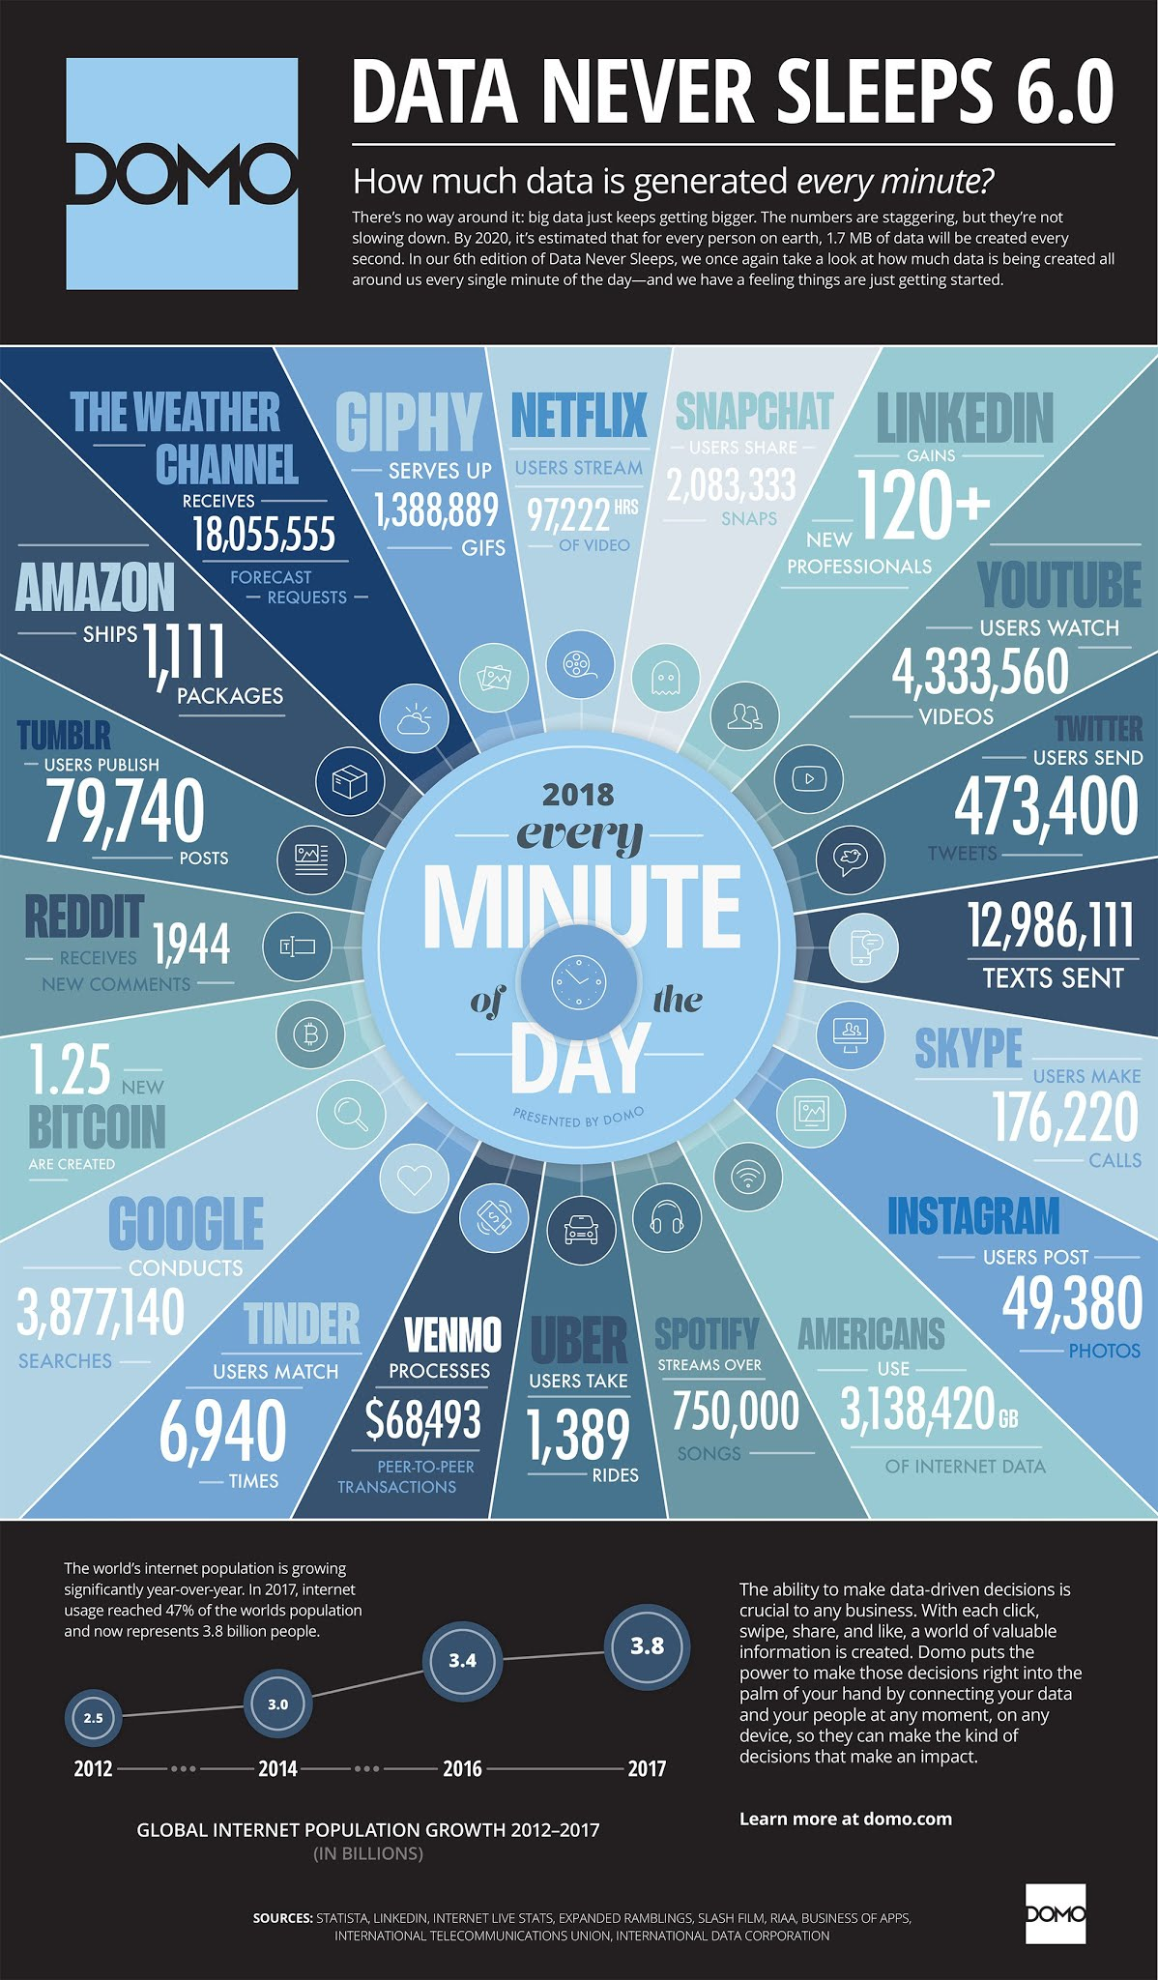
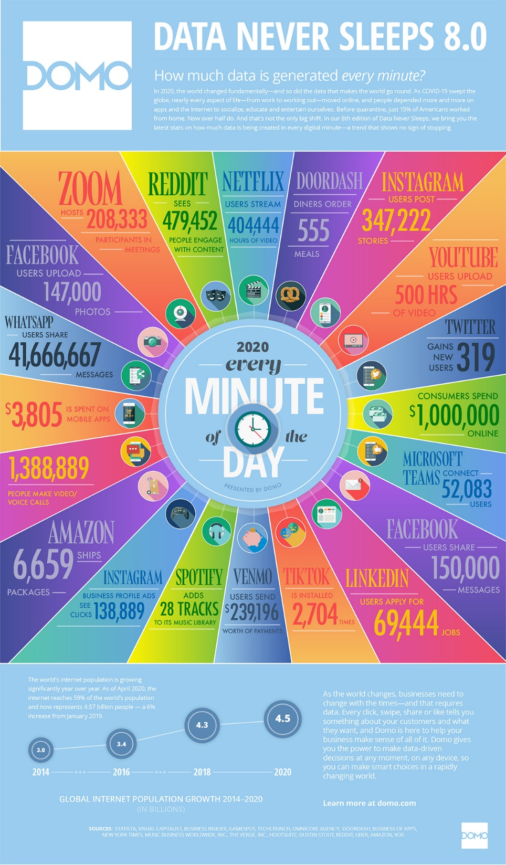

Slide 23
Big Data – why?
The rate of growth in the amount of data generated and stored has been increasing exponentially. (faster than Moore’s Law)
One significant shift is in the amount of unstructured data
micro-texts, relationship data, images and videos
Big Data truly represents a fundamental change in the architecture needed to efficiently handle current datasets.
Old Relational data model insufficient

Slide 24
Open Questions
What attributes define Big Data solutions?
How is Big Data different from traditional data environments and related applications?
What are the essential characteristics of Big Data environments?
How do these environments integrate with currently deployed architectures?
What are the central scientific, technological, and standardization challenges that need to be addressed to accelerate the deployment of robust Big Data solutions?

Slide 25

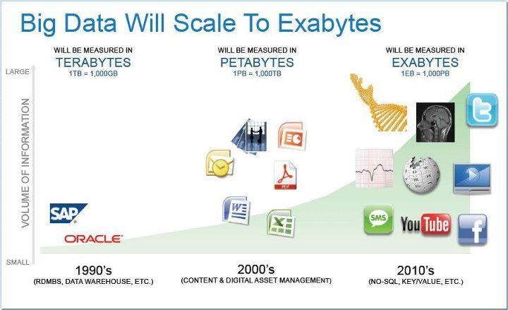
Big Data
Big Data consists of extensive datasets, primarily in the characteristics of volume, variety, velocity, and/or variability that require a scalable architecture for efficient storage, manipulation, and analysis. [2]
http://www.cs.us.es/~fsancho/?e=79

Slide 26
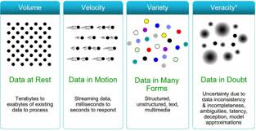
The 4 Vs of Big Data ^{[1]}
Data at Rest - Volume
Data in Motion - Velocity
Data in many forms – Variety
Data in Doubt - Veracity

Slide 27
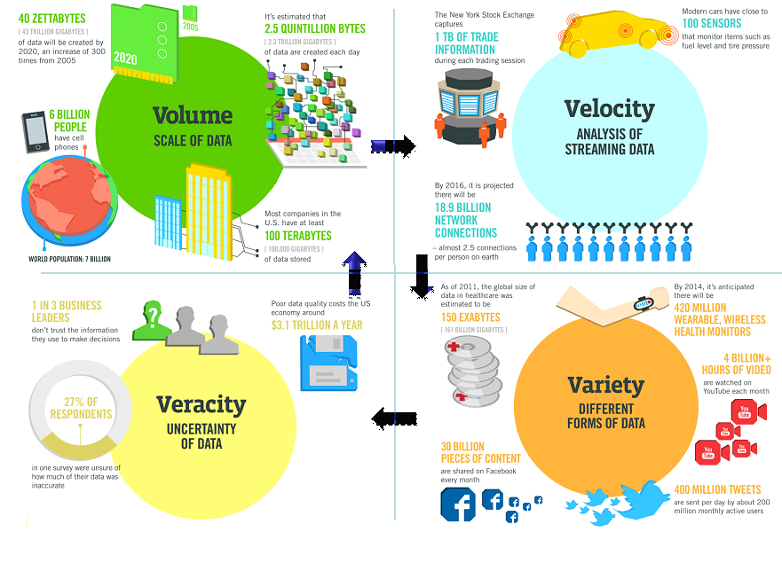
source: © IBM

Slide 28
Data Science
Data analytics and visualization.
Cleaning data,
Actionable Data
Mining knowledge — turning it into conclusions.
Infrastructure.
Point-of-sale systems that are collecting the data
Long-term archival storage
Data curation
That is over the long-term making the data available for reuse, for repurposing.
Need good metadata.

Slide 29
Data Science
The data science paradigm is extraction of actionable knowledge directly from data through a process of discovery, hypothesis, and hypothesis testing.
The data lifecycle is the set of processes that transform raw data into actionable knowledge.
Analytics is the synthesis of knowledge from information.
With the new Big Data paradigm, analytics are no longer separable from the data model and the distribution of that data across horizontally-scaled resources.

Slide 30
References
Delivering Foresight-as-a-Service (FaaS), Laura Haas, IBM Fellow
NIST Big Data Program Documents, https://www.nist.gov/itl/big-data-nist/big-data-nist-documents/nbdif-version-30-final
NIST Big Data Taxonomy, http://bigdatawg.nist.gov

